Slide 1
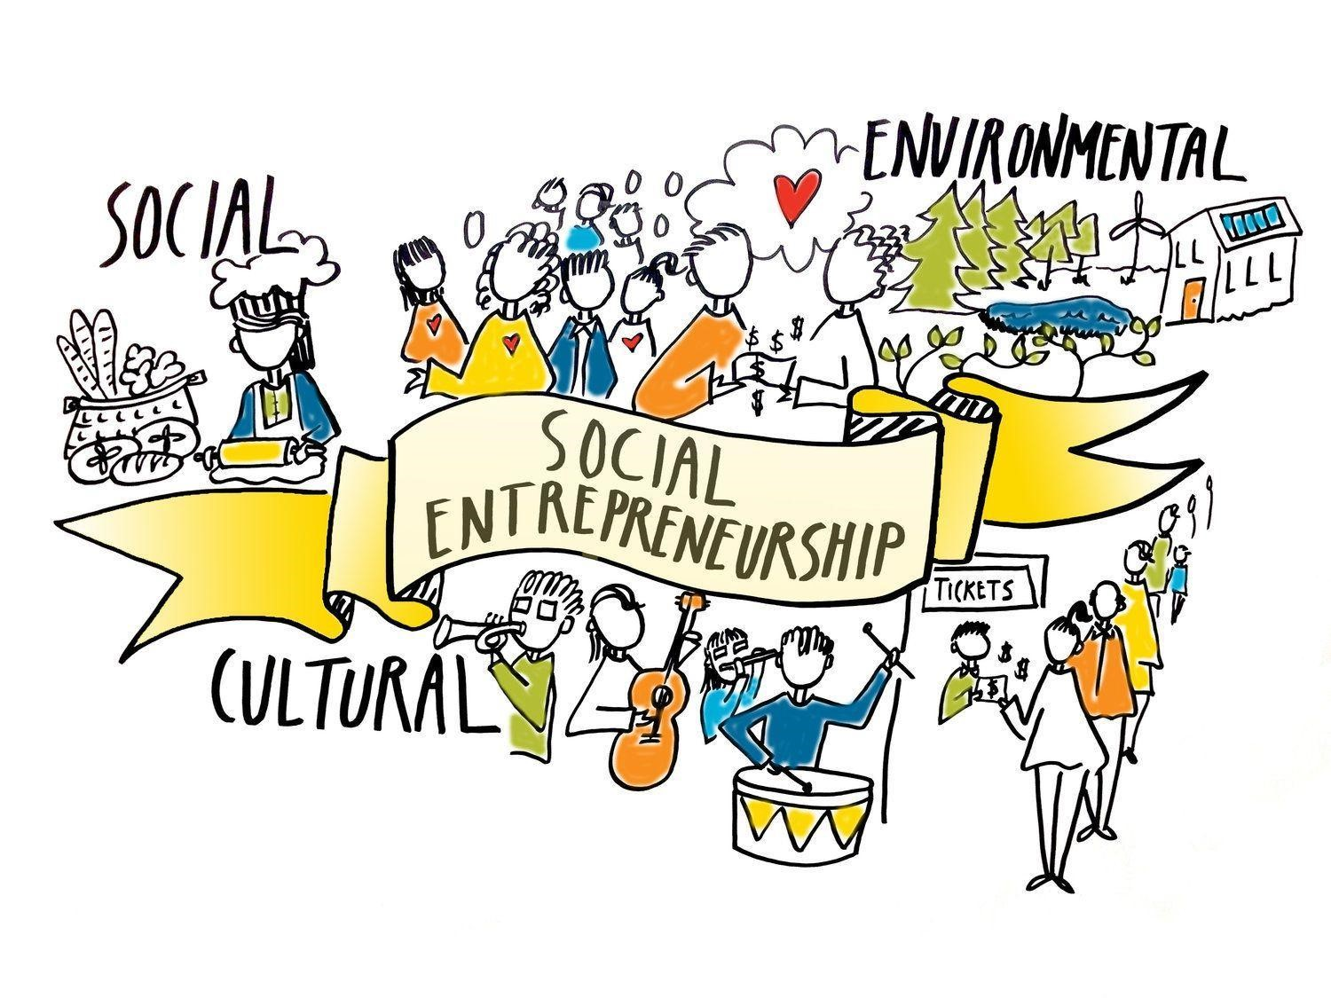
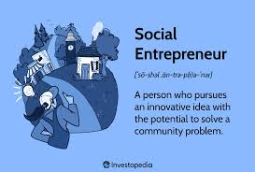
Week 9
CIVICS & COMMUNITY ENGAGEMENT
Social Entrepreneurship & Civic Innovation
Purpose · Models · Ethics · Pakistan Context
Rabia Zia | rabia.zia@nu.edu.pk

Slide 2
What We Will Cover
01
02
03
04
05
06
07
What is Social Entrepreneur-ship?
SE vs Charity, NGO & CSR
Problems as Opportunities
Impact & Financial Sustainability
Social Enterprise Models
Ethical Challenges
Registering in Pakistan
Definition, civic innovation, and the mindset behind it
How these models differ in purpose, funding, and accountability
Reframing social challenges as the foundation for sustainable solutions
The dual bottom line: balancing mission and money
Non-profit, for-profit, hybrid — structures and trade-offs
Six key tensions every social entrepreneur faces
High-level overview of legal structures and registration pathways
Social Entrepreneurship & Civic Innovation

Slide 3
What is Social Entrepreneurship?
Social Entrepreneurship is the practice of identifying persistent social, cultural, or environmental problems and creating sustainable, innovative solutions to address them — using entrepreneurial principles rather than relying purely on charity or government. The social entrepreneur's primary goal is lasting social change, while generating enough income to sustain and scale that change.
Core Characteristics of a Social Entrepreneur
Civic Innovation
Mission-first mindset
Civic innovation applies social entrepreneurship to governance and community life. It asks: how can citizens solve problems that government is too slow or under-resourced to address?
Social impact is the primary objective. Revenue is a means to achieve and sustain that mission — not the end goal itself.
Sees problems as opportunities
Where others see a social problem, the social entrepreneur sees an unmet need and a chance to build a solution that is both needed and viable.
Examples:
Community-run libraries or skill-sharing hubs in underserved areas
Tech platforms that help citizens report civic problems to local authorities
Social enterprises providing affordable solar energy to off-grid villages
Youth-led waste management co-operatives in urban areas
Innovative approach
Applies new thinking, new models, or new technology — rather than simply replicating what charities or government already do.
Accountability to beneficiaries
Unlike traditional businesses accountable often only to shareholders, social enterprises are accountable to the communities they serve.
Measurable impact
Tracks social outcomes (lives changed, behaviour shifted, access improved) alongside financial metrics like revenue and cost.
Social Entrepreneurship & Civic Innovation

Slide 4
Social Entrepreneurship vs. Charity, NGOs & CSR: Key Differences
Social Enterprise
Charity
NGO / Non-Profit
CSR Programme
Primary Goal
Create sustainable social impact through a self-funding model
Relieve immediate suffering or need through giving
Advocate for a cause or deliver services to a community
Enhance a company's reputation and meet social obligations
Funding Model
Earns its own revenue through products, services, or social contracts
Donations, grants, fundraising — external and one-time
Grants, memberships, donations — largely donor-dependent
Funded by a parent corporation; not independent
Profit
May generate profit — reinvested into the mission
No profit generated; all income goes to operations/programmes
Surplus reinvested; distributing profit to owners is restricted or banned
No separate profit — costs absorbed by parent company
Sustainability
Designed to be self-sustaining without ongoing donations
Relies on continued donor generosity — can disappear if funding stops
Long-term but dependent on external funding cycles
Continues as long as parent company chooses to fund it
Accountability
To beneficiaries, investors/donors, and regulators
To donors and beneficiaries
To donors, members, and beneficiaries
To parent company shareholders and brand image
Scale Potential
High — can scale like a business through reinvestment and growth
Limited by donation levels and volunteer capacity
Moderate — constrained by grant cycles and donor priorities
Limited by corporate budget decisions
Social Entrepreneurship & Civic Innovation

Slide 5
Social Problems as Opportunities for Sustainable Solutions
The reframe: A social problem is evidence of an unmet need at scale. Where there is an unmet need, there is a potential market and a potential source of sustained social change. Social entrepreneurs ask: 'Who suffers from this? What do they need? And how could we build something that reliably delivers that?'
The Problem-to-Opportunity Reframe
Real Examples: Problems Become Enterprises
1
Name the Problem
Problem: Rural illiteracy & no local schools
Who is affected? How many people? How severely? What are the consequences of it remaining unsolved?
Solution: Teach For Pakistan places graduates in under-resourced communities — building local capacity rather than donating textbooks.
2
Understand Root Causes
Use the 5 Whys or similar tools to get past symptoms and understand why the problem persists structurally.
Problem: Unaffordable healthcare in low-income areas
Solution: Sehat Kahani connects women doctors to patients via teleconsultation — cutting costs while utilising unemployed female physicians.
3
Identify the Gap
What solution currently exists — and why is it insufficient, inaccessible, unaffordable, or unsustainable?
Problem: Urban waste accumulating with no collection
4
Ask: Who Benefits?
Solution: RecycleX buys recyclables from informal waste pickers in Karachi — generating income and cleaner cities simultaneously.
Who would pay, partner, or donate to see this problem solved? This reveals your potential revenue or funding sources.
Problem: Women excluded from formal financial services
5
Prototype a Solution
Solution: Akhuwat provides interest-free loans to low-income entrepreneurs using a community solidarity model.
Design a minimum viable solution — small, fast, and testable — that addresses the core gap without waiting for perfection.
Social Entrepreneurship & Civic Innovation

Slide 6
Balancing Social Impact & Financial Sustainability: The Dual Bottom Line
Traditional businesses have one bottom line: profit. Social enterprises have two: social impact AND financial sustainability. Neglecting either one leads to failure — an organisation that runs out of money cannot serve anyone, and one that abandons its mission has no reason to exist.
Social Impact
Financial Sustainability
What it means:
What it means:
Social impact refers to the measurable change in community wellbeing, equity, opportunity, or environmental health that results directly from the enterprise's activities.
Financial sustainability means the enterprise consistently generates enough income — through sales, fees, grants, or a mix — to cover its costs and invest in growth, without relying on one-time or unreliable funding sources.
How it is measured:
How it is measured:
Number of people whose situation improved
Depth of change (small shift vs. transformational change)
Reach: local, regional, or national scale
Sustainability: does change persist after the intervention ends?
Attribution: can we prove the enterprise caused this change?
Revenue covers operating costs (break-even minimum)
Surplus is generated and reinvested in mission
Diverse income streams reduce dependency on any single source
Working capital is sufficient to weather short-term gaps
The financial model can scale as the social mission grows
⚠ Risk if ignored: Too much focus on impact without financial discipline = the organisation runs out of money and disappears. Passion is not a substitute for a viable revenue model.
⚠ Risk if ignored: Too much focus on money without mission discipline = the enterprise 'mission drifts' — it starts serving paying customers rather than the people it was built to serve.
Social Entrepreneurship & Civic Innovation

Slide 7
Social Enterprise Models: The Non-Profit Structure
Social enterprises can take three broad structural forms: non-profit, for-profit, and hybrid. Each has distinct legal, financial, and mission implications. Understanding which model fits your context is one of the first strategic decisions an entrepreneur must make.
Model 1: Non-Profit Social Enterprise
What It Is
Advantages & Limitations
A non-profit social enterprise is a legally registered organisation that uses commercial activities to generate revenue — but is prohibited (or chooses) not to distribute profits to owners or shareholders. All surplus is reinvested into the social mission.
Advantages:
Tax-exempt status reduces operational costs and increases donor appeal
Eligible for grants and government contracts not available to for-profits
Strong public trust — donors, communities, and governments prefer non-profit structures
Mission protection built into legal structure — profit cannot distract from purpose
Funding sources:
Programme fees · Grant income · Donations · Membership subscriptions · Government contracts · Social enterprise revenue from products/services
Pakistan examples:
Limitations:
Akhuwat Foundation · The Citizens Foundation (TCF) · Edhi Foundation · Teach For Pakistan · Naya Jeevan Health Insurance
Cannot raise equity capital from investors — limits growth speed
Heavy dependence on grants can create unstable, short-term planning horizons
Governance and reporting requirements can be administratively burdensome
Attracting top talent is difficult when salaries are capped by donor expectations
Registered under: Section 42 Companies Act 2017 (Pakistan) or as a Trust/Society
Social Entrepreneurship & Civic Innovation

Slide 8
Social Enterprise Models: For-Profit & Hybrid Structures
Model 2: For-Profit Social Enterprise
What It Is
Advantages & Limitations
A for-profit social enterprise is a standard private company (sole trader, partnership, or limited company) whose core business model is designed around solving a social problem. Investors receive financial returns, but the enterprise's products or services inherently create social value.
✔ Can raise equity investment and scale rapidly using business growth strategies
✔ No donor dependence — revenue from customers sustains the mission
✔ Easier to attract skilled talent with market-rate salaries
Examples: Grameen Bank (Bangladesh) · Sehat Kahani (Pakistan teleconsultation) · D.light solar lamps (off-grid rural customers)
✘ Investor pressure can lead to mission drift if financial returns are prioritised
✘ No tax exemptions or eligibility for grants available to non-profits
Model 3: Hybrid Social Enterprise
Cross-subsidy
Earned income non-profit
A profitable product or service line funds a subsidised or free service for low-income beneficiaries. Example: a private clinic charges full-fee patients to subsidise free clinics for the poor.
A non-profit sells products or services to generate revenue, which funds its charitable programmes. Example: a disability charity runs a catering business to fund its training programmes.
Co-operative
Social franchise
Owned and democratically controlled by its members — workers, customers, or community. Profits distributed among members. Example: Dairy farmer co-ops that pay fair prices and share surpluses.
A proven social enterprise model is replicated by licensed partners in new locations — like a franchise but for impact. Example: Akhuwat's microfinance model replicated across Pakistan.
Social Entrepreneurship & Civic Innovation

Slide 9
Choosing a Model: At-a-Glance Comparison
Non-Profit SE
For-Profit SE
Hybrid SE
Profit distribution
Not permitted — all surplus reinvested
Permitted — investors receive returns
Partial — depends on hybrid structure
Capital raising
Grants, donations, government contracts
Equity investment, commercial loans
Mix of grants, investment, and revenue
Tax status
Tax-exempt in most jurisdictions
Standard business taxation applies
Varies by structure and jurisdiction
Mission protection
Strong — legally mandated
Weaker — depends on founder/investor alignment
Moderate — depends on legal design
Growth speed
Slower — limited by grant cycles
Faster — can leverage investment
Moderate — depends on chosen model
Best suited when...
Community trust is critical; project needs grants; no viable paying market
A real market exists; investors can align with mission; scale is needed fast
Some paying customers + some beneficiaries who cannot pay; cross-subsidy needed
Social Entrepreneurship & Civic Innovation

Slide 10
Ethical Challenges in Social Entrepreneurship
Social entrepreneurs face a unique set of ethical tensions because they operate at the intersection of business (which is driven by incentives) and social change (which is driven by values). Unlike a traditional business that can ignore ethics if it remains profitable, a social enterprise that loses its ethical compass loses its reason to exist.
1. Mission Drift
2. Paternalism
The organisation gradually shifts its activities away from its original social mission — usually because profitable activities are prioritised over impactful but less profitable ones.
Designing solutions for communities without meaningful involvement from those communities — essentially deciding for people what they need, rather than asking them.
Example: A microfinance institution that starts targeting wealthier clients because they repay more reliably, abandoning the poorest borrowers it was created to serve.
Example: An NGO that builds wells in a village without consulting residents, only to discover the community preferred to solve water scarcity through a different mechanism.
3. Impact Washing
4. Exploitation of Beneficiaries
Overstating, misrepresenting, or cherry-picking evidence of social impact to attract donors, investors, or public goodwill — similar to 'greenwashing' in the environmental space.
Using beneficiaries' stories, data, or images without proper consent, or in ways that are sensationalised, disempowering, or humiliating — even with good intentions.
Example: Reporting that 10,000 students 'benefited' from a programme, while concealing that 'benefit' was defined as receiving a single brochure.
Example: Using photographs of malnourished children without consent to raise funds, in a way that reduces complex people to their suffering.
Social Entrepreneurship & Civic Innovation

Slide 11
Ethical Challenges in Social Entrepreneurship
5. Unsustainable Dependency
6. Governance & Accountability Gaps
Creating programmes that make beneficiaries dependent on the enterprise rather than building their own capacities and agency over time.
Lack of transparent governance structures means that even well-intentioned leaders can make decisions that serve personal interests rather than the mission.
Example: A food distribution programme that delivers meals indefinitely, suppressing local food markets and creating chronic dependency on the enterprise.
Example: A founder who controls the board and uses the enterprise's resources for personal benefit or prevents the organisation from being questioned or audited.
3. Impact Washing
5. Unsustainable Dependency
Social Entrepreneurship & Civic Innovation

Slide 12





Navigating Ethical Challenges: Principles & Practical Checks
Ethical challenges cannot be eliminated — but they can be anticipated, openly discussed, and managed through good governance and honest self-reflection. The following principles and checks help social entrepreneurs stay on track.
Do No Harm
Transparency
Meaningful Participation
Honest Impact Measurement
Independent Governance
Before any programme or decision, ask: who could be harmed by this — directly or indirectly? Consider unintended consequences. Include beneficiary voices in risk assessments.
Publish your impact data, your finances, and your governance structure. If you would be uncomfortable with stakeholders seeing a decision, reconsider it.
Beneficiaries are experts on their own lives. Involve them in problem definition, solution design, and evaluation — not just as recipients of your outputs.
Measure outcomes, not just outputs. 200 workshops held ≠ 200 lives changed. Use control groups, pre/post comparison, and independent evaluation where possible.
Have a board with members who are genuinely independent of the founder. Empower them to question, challenge, and if necessary override leadership decisions.
Ask yourself:
Ask yourself:
Ask yourself:
Ask yourself:
Ask yourself:
Who could be harmed if this goes wrong?
Would we publish this decision and be proud?
Have those affected had a real say?
Are we measuring what actually matters?
Could the board override me if needed?
Social Entrepreneurship & Civic Innovation

Slide 13
Registering a Social Enterprise in Pakistan: High-Level Overview
Pakistan does not yet have a dedicated 'social enterprise' legal category. Social entrepreneurs must choose the most appropriate existing legal structure based on their model. Each structure has different registration bodies, tax implications, and governance requirements.
Section 42 Company
(Non-Profit)
Trust or Society
(Non-Profit)
Private Limited
Company (SMC/Multi)
Co-operative Society
Registered by: SECP (Securities & Exchange Commission of Pakistan)
Registered by: Provincial Social Welfare Departments
Registered by: SECP
Registered by: Provincial Co-operative Departments
Best for: Mission-led non-profits, social enterprises with no profit distribution
Best for: Community organisations, foundations, local welfare bodies
Best for: For-profit social enterprises, hybrid models, social startups seeking investment
Best for: Member-owned enterprises (farmers, artisans, workers)
Key advantages:
Key advantages:
Key advantages:
Key advantages:
Tax-exempt status available (FBR registration)
Eligible for institutional grants and government contracts
Formal legal personality — can own assets, sign contracts
Most recognized structure for international funding
Simpler registration than SECP for smaller organisations
Long-established legal form with broad community recognition
Suitable for charitable giving and service delivery
Each province has its own Trusts or Societies Act
Can raise equity investment from shareholders
No restriction on profit distribution
Full access to commercial banking and contracts
Eligible for SMEDA support and startup programmes
Democratic governance — one member, one vote
Profit shared among members, not investors
Provincial government often provides support
Ideal for community economic empowerment
⏱ 4–8 weeks
⏱ 2–6 weeks
⏱ 2–4 weeks
⏱ 3–8 weeks
File Memorandum & Articles with SECP → SECP approval → FBR registration → Tax exemption (where applicable)
File deed/constitution with Provincial Registrar → Registration → Open bank account under organisation name
Name reservation with SECP → Company registration → NTN with FBR → Provincial trade licence
File application with Provincial Co-operative Registrar → Approval → Annual compliance required
Social Entrepreneurship & Civic Innovation

Slide 14
KEY TAKEAWAYS
Social Entrepreneurship & Civic Innovation
Definition
Social entrepreneurship uses business principles to create lasting social change. Civic innovation applies this to public and community problems. The goal is always impact first, revenue as the enabler.
Key difference
Unlike charities (donor-dependent) or CSR (brand-driven), social enterprises are designed to be self-sustaining. They serve a social mission AND generate enough income to keep doing so without constant external funding.
Opportunities
Every persistent social problem is a signal of an unmet need. The social entrepreneur's job is to reframe that problem as a design challenge: who is suffering, why does no solution exist yet, and what would a viable one look like?
Dual bottom line
Impact and financial sustainability are equally important. Mission without money is unsustainable. Money without mission is just a regular business. Both must be actively tracked and balanced.
Models
Non-profit, for-profit, and hybrid models each have different trade-offs. The right choice depends on who you serve, whether a paying market exists, and what funding sources are realistic for your context.
Ethics
Social entrepreneurs face unique ethical tensions — mission drift, paternalism, impact washing, dependency creation. Strong governance, transparency, beneficiary participation, and honest measurement are the antidotes.
Pakistan
No dedicated SE legal category exists. Choose: Section 42 Company, Trust/Society, Private Limited Co., or Co-operative — based on your model.
Social Entrepreneurship & Civic Innovation · End of Lecture

